Slide 1

Anti-DDoS prevention measures through MRU task scheduling principles
By Brandon Vo

Slide 2
Introduction
As the world starts to depend more on the internet and as the processing power of an average computer continues to grow, DDoS attacks have become more dangerous and accessible as time goes on.
Over 5.4 million DDoS attacks were conducted in 2021 with attacks reaching a bandwidth limit of 1.5 terabytes/s
Amazon had experienced the largest DDoS attack in the world during 2020, dealing with an attack that had the bandwidth limit of 2.3 terabytes/s
Source: https://www.missioncriticalmagazine.com/articles/93811-a-record-number-of-ddos-attacks-were-reported-this-year
https://www.bbc.com/news/technology-53093611
As time goes on, these attacks will only grow larger and more accessible with the increase usage and accessibility of botnets which creates fears that the adversary will eventually out scale the processing power of a server owner

Slide 3
Countermeasures and related research
Other researchers have looked into defense mechanisms for identifying and mitigating DDoS attacks.
[2] A. Sardana’s research looked into using what are known as honeypot servers, or servers that are openly placed on a network to attack attackers, in order to receive the intake of DDoS messages and tag them before sending these messages to a legitimate server.
[4] Raymond Choo’s research looked into a defense mechanism where an emergency server could be deployed to serve as additional aid to help service the influx of queries.
However, this design required additional resources to be available on-demand. A trait that benefits primarily cloud-computing services.
And [1] Bremler-Barr’s dwelved into research regarding anti-DDoS prevention measures designed to identify potential DDoS packets and reject them.
Many of these research methods were designed to adjust to handle the scale of DDoS attacks.

Slide 4
Proposed Idea
In Operating Systems, the CPU always has to deal with a variable, but large scale set of tasks to perform for the system.
The CPU scheduler has a preemptive, priority-based system that allows the CPU to assign tasks and identify what types of tasks require the most priority to finish and which tasks to delay.
It could be possible to implement these techniques for a server handling a network such that the server would identify what to services to focus and which to delay.
This would allow a server to maintain quality of service for users already connected to the server, and it would allow administrators to have high priority access in order to maintain control of their server.

Slide 5
Implementation
The design of this experiment begins with a simulated network designed in Mininet, a software used to create local networks.
This network was made under a custom topology explained below.
This network was made with 4 layers:
Core Layer: The root of the main switch. Connects all switches in the aggregation layer, allowing all hosts to communicate with each other.
Aggregation Layer: A layer of switches to connect the networks found in the edge layer.
Edge Layer: Creates several local networks of hosts which can communicate with each other
Host Layer: Contains 32 machines. 1 host will act as a server while the remaining 31 machines will act as client computers or attackers.
While the total number of hosts can be variable, additional hosts would require additional CPU power which the virtual machine could not provide. Anymore would cause the network to crash.
This is to recreate Cisco’s three-layer hierarchical network model of a data center.
The server and clients will also be running on UDP as DDoS attacks under TCP and UDP have extremely different methods. UDP is the more straightforward method of DDoS attacks which more closely resemble real-life botnet attacks.

Slide 6
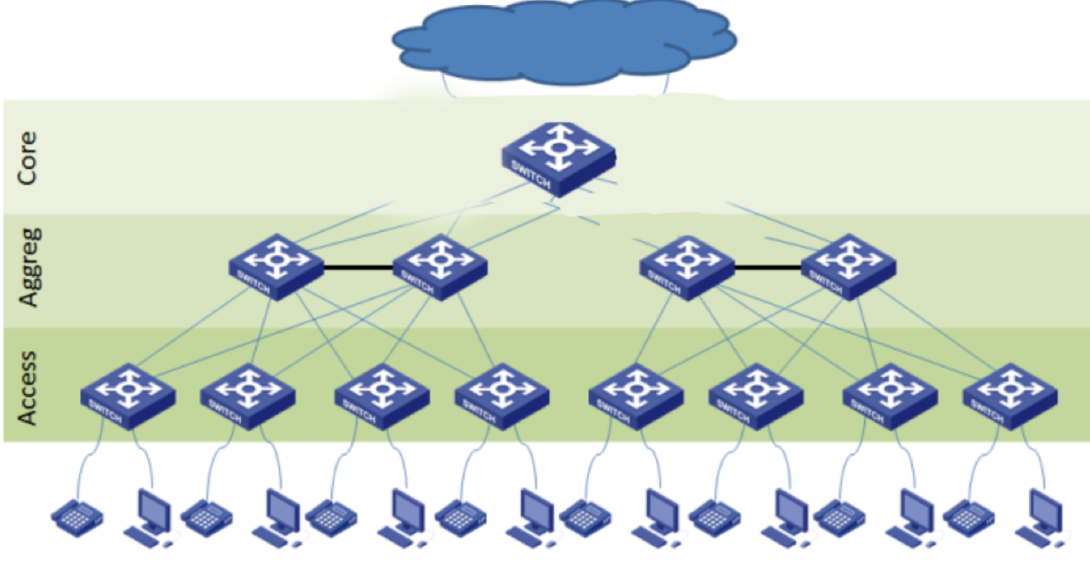

Slide 7
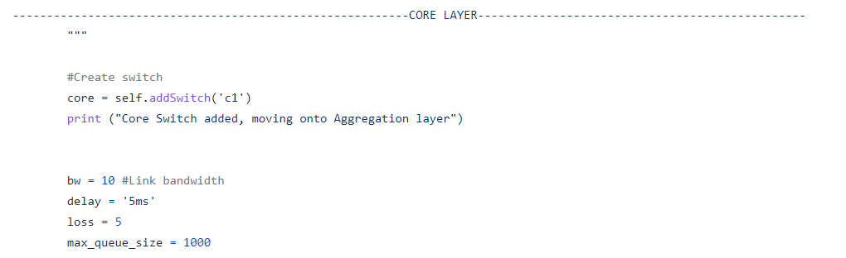
Core Layer
The network was also built with an intentional bandwidth limited, delay time, and possibility of packet lost to emulate the imperfection of a network as well.
Every layer will be created with this imperfection as part of the cascade effect of packet lost in a network.

Slide 8
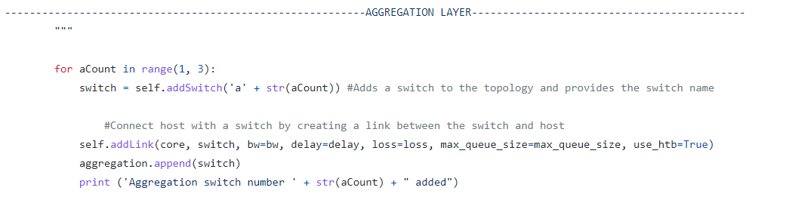
Aggregation Layer

Slide 9
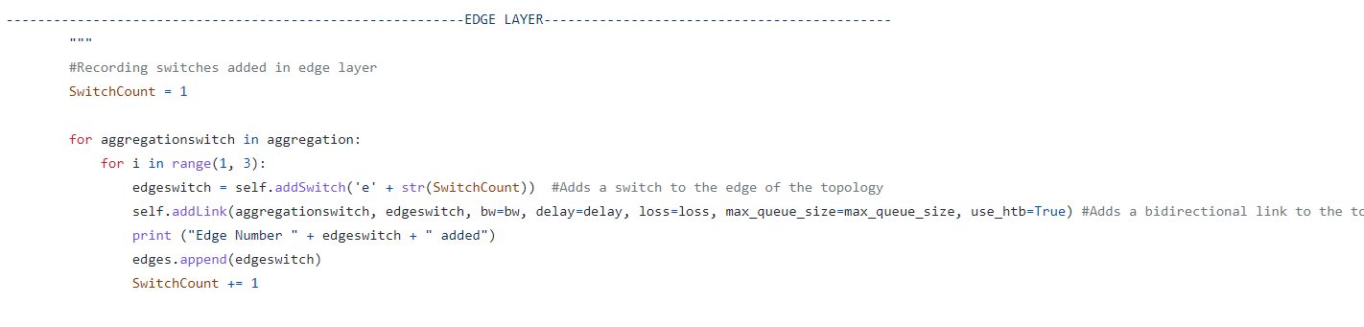
Edge Layer

Slide 10
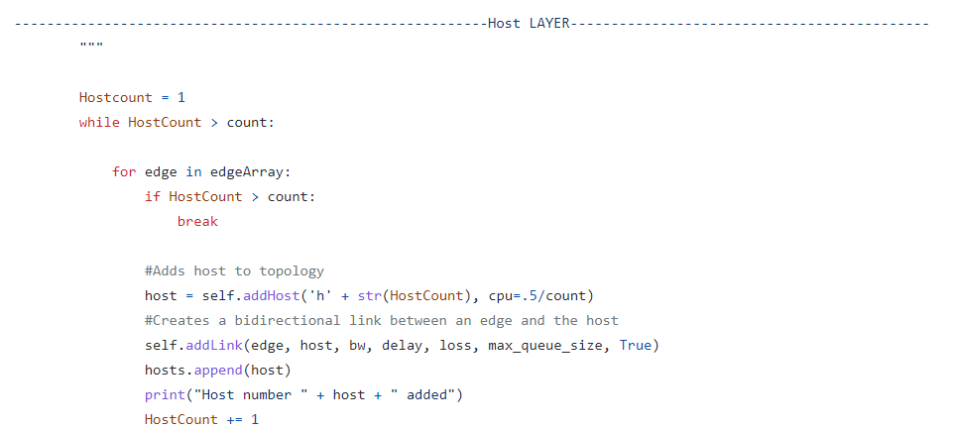
Host Layer

Slide 11
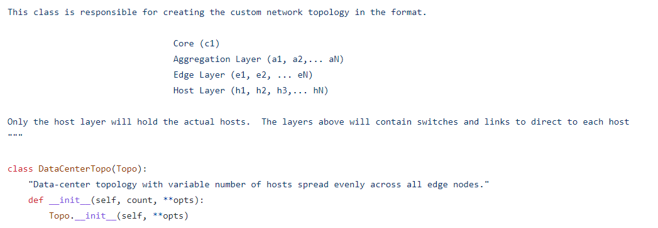
Code Implementation

Slide 12
Implementation
In order to emulate a low-end server, the topology is intentionally built with CPU limitations. Each host are provided with a portion of allotted CPU resources by the Unix virtual machine.
The host chosen to be the server will run a simple program in which upon receiving a request, the server will run a random number generator. If it meets a certain threshold, the server will be allowed to respond to the client. Otherwise, the server will have to keep generating a random number.
Meanwhile, clients will be split into legitimate clients or attackers.
Clients will send requests to the server at random intervals given by a random number generator to emulate an actual client who provides requests at irregular intervals.
Attackers, on the other hand, will send the same requests to the server, but they will not be limited to waiting. Attackers will continuously keep sending requests to the server.

Slide 13
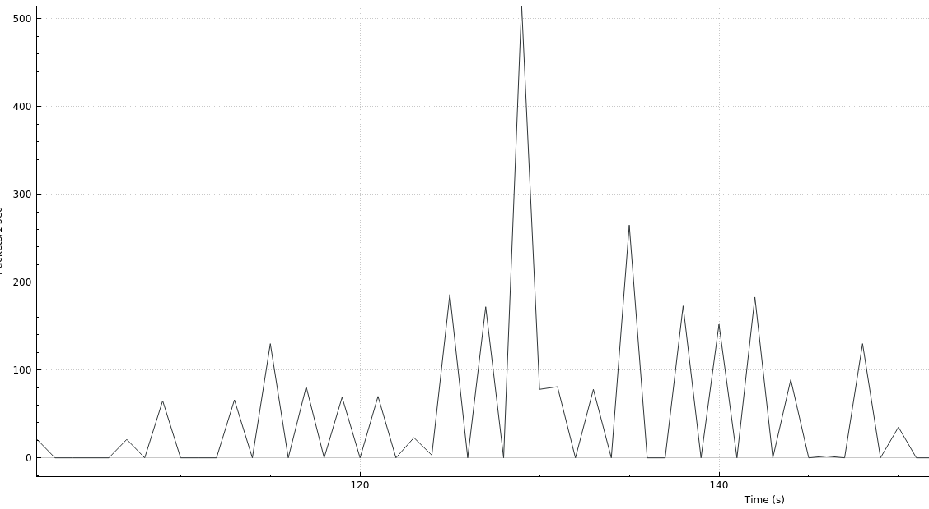
First Experiment
Three sets of trials were conducted with 1 host and 31 clients.
Because Mininet requires some time to create the simulated network and the 32 hosts, there is little to no activity in the time preceding the recorded data.
Wireshark was used to record the I/O data of the network to see how much traffic was being sent and responded to in terms of packets sent (y axis) over time in seconds (x axis)

Slide 14
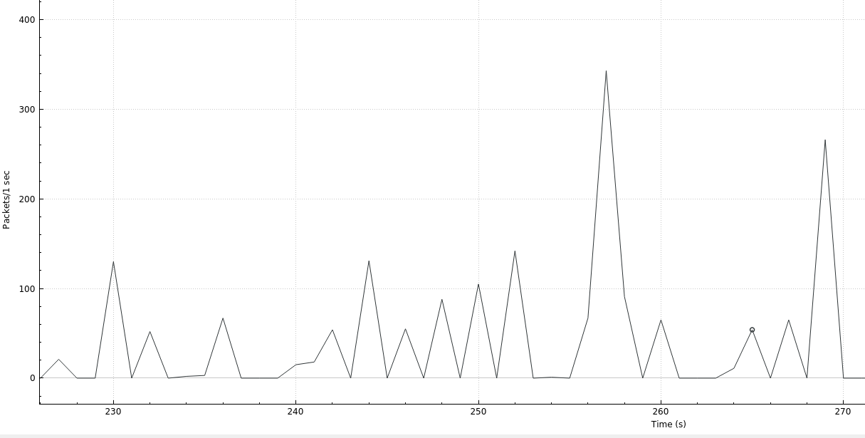
First Trial

Slide 15
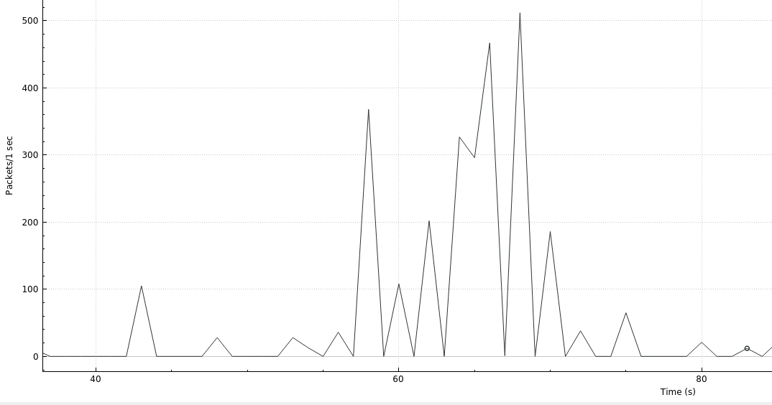
First Trial

Slide 16
First Trial
As shown in the recorded network flow, there is moderate activity with an occasional spike before operations ceased activity.
The largest amount of activity spikes to either 400 pks/s or 500 pks/s and only once.
The occasional spikes in activity can be explained by the random interval at which clients send requests. This means that occasionally, clients will send large amounts of requests to the server.

Slide 17
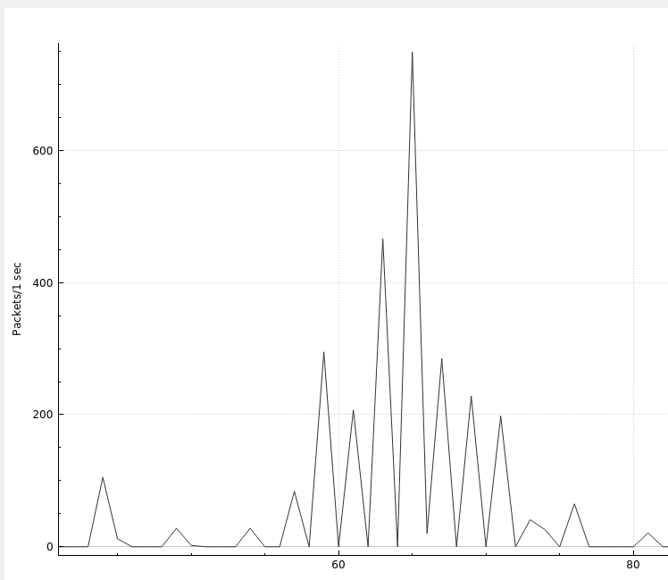
Second Trial
For the next trial, the same network topology was used; however, all client users were converted into attackers which would spam the server with constant requests to see how the network would be affected.

Slide 18
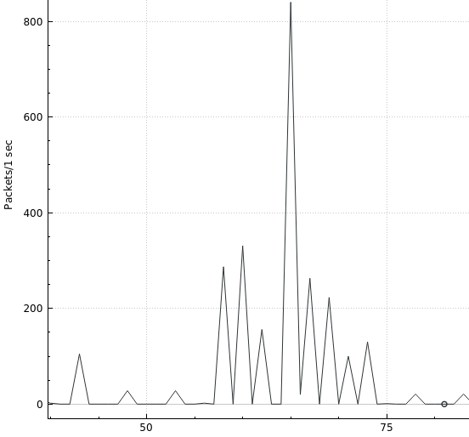
Second Trial

Slide 19
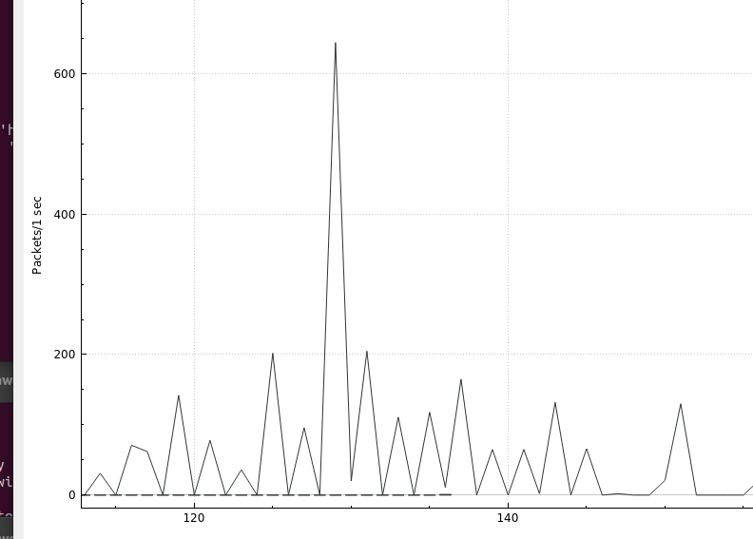
Second Trial

Slide 20
Second Trial
While the difference isn’t very great, this is taking place on a small-scale network on a low-end CPU, meaning that the small increase in I/O performance can be enough to slow down the server.
The I/O peaks now exceed 600 pk/s, going as far as 800 pk/s.
There is now a greater interval frequency as the server is now constantly replying to messages sent by the attackers, meaning less possibilities for downtime.
While the first trial had an average of 100 pk/s for its normal operations, the network’s traffic has doubled in size to 200 pk/s.
Such a sudden increase in I/O would mean that the server has to undergo twice as much activity than usual or up to 8 times as much if unable to properly handle the large amounts of incoming requests.

Slide 21
Third Trial
This trial set up similarly to the second experiment except the server will be an implementation of an anti-DDoS processing scheduler.
The way it functions is by the most-recently used principle.
The server would keep track of the source IP Addresses received along with the number of times the server had received a message from that IP address.
The server will now store the messages into a queue and work on these messages normally.
Once the queue reaches maximum capacity, the server will now consult the list of recorded IP Addresses. Upon receiving a new message, the server will have to check if the message came from an IP Address that was previously recorded.
If the IP Address was found, then the server will service the message as normal and increment a counter for that IP Address
If a matching IP Address wasn’t found, then the server will put the message back in queue and work as normal.
However, if the server has counted that an IP Address was serviced above a certain threshold and a matching IP address wasn’t found, the server will remove the most used IP Address and replace it with the new IP Address from the message.

Slide 22
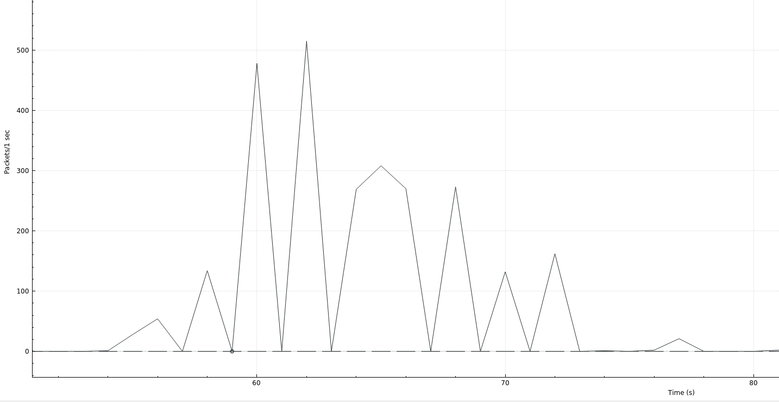
Third Trial

Slide 23
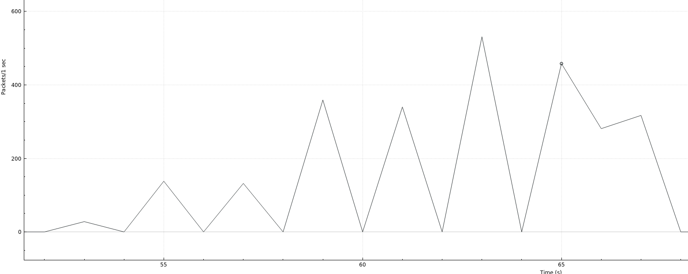
Third Trial

Slide 24
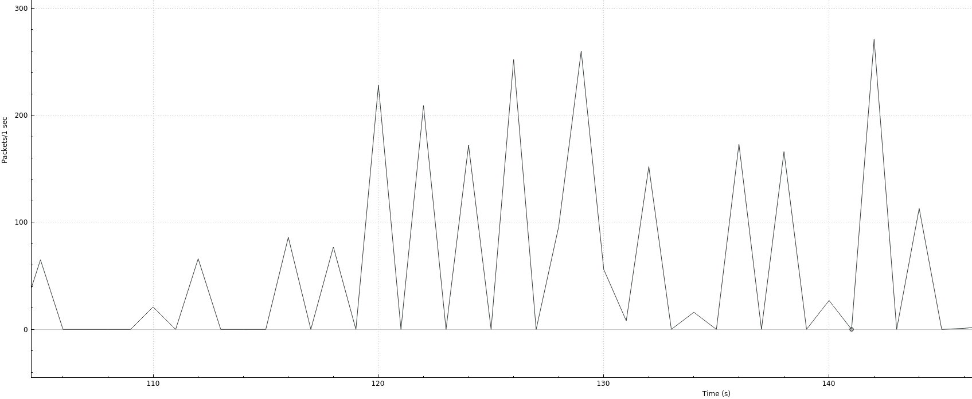
Third Trial

Slide 25
Results
The third trial no longer has large spikes in activity but seems to have spread the influx of workflow over longer periods of time.
While the traffic network averages out at approximately 200 pk/s as the second trial, the intervals are noticeably wider and less frequent as there are less spikes in activity compared to the first or third trial.
Instead of several messages being sent and received rapidly, the server now responds to messages at longer but more consistent intervals of time.
Overall, the MRU anti-DDoS mechanism has demonstrated a noticeable effect for all three trials against a botnet.

Slide 26
Conclusion
While the third trial shows signs of the mitigation effects to be working, results are ultimately inconclusive.
The trial with anti-DDoS measures showed a shift from intermittent bursts of network queries to a less-intensive but more drawn-out series of request handling.
It is unknown if this alternative form of packet handling is more ideal for clients and/or the server as the network simulation was designed primarily to observe packet flow, not user and host experience.
It is uncertain if this method has led to better performance for the server in terms of CPU network performance, and the impact on the server in terms of processing power is unknown.
The server’s CPU processing power was not taken into account because the server was virtually hosted on Mininet which does not allow for a method to measure its processing power, so this cannot be tested.

Slide 27
Flaws and possible improvements
While Mininet provided an accessible means, it also provided severe limitations which hampered the accuracy of the experiment.
The simulated network topology created was created on one CPU. While each host was allotted a set amount of CPU processing power along with intentional imperfections in the network, it could not be determined how performance was affected by every host essentially sharing the same pool of resources.
It could be possible that as the botnet slowed down the server host, the reduction in available processing power could’ve affected the botnet as well, causing the DDoS attack to become weaker if it was effective.
The host should have performed more resource intensive functions similar to what an actual server would perform. This would be able to better capture the strain that the server would be put under during an actual DDoS attack.

Slide 28
Bibliography
[1][ A. Bremler-Barr, E. Brosh and M. Sides, "DDoS attack on cloud auto-scaling mechanisms," IEEE INFOCOM 2017 - IEEE Conference on Computer Communications, 2017, pp. 1-9, doi: 10.1109/INFOCOM.2017.8057010.
https://ieeexplore.ieee.org/abstract/document/8057010
[2] A. Sardana and J. R.C., "An Integrated Honeypot Framework for Proactive Detection, Characterization and Redirection of DDoS Attacks at ISP Level," Journal of Information Assurance and Security 1, vol. 1, no. 1, pp. 1-15, 2008.
https://citeseerx.ist.psu.edu/viewdoc/download?doi=10.1.1.580.3346&rep=rep1&type=pdf
[3] G. Somani, M. S. Gaur, D. Sanghi, M. Conti and M. Rajarajan, "Scale Inside-Out: Rapid Mitigation of Cloud DDoS Attacks," in IEEE Transactions on Dependable and Secure Computing, vol. 15, no. 6, pp. 959-973, 1 Nov.-Dec. 2018, doi: 10.1109/TDSC.2017.2763160.
https://ieeexplore.ieee.org/abstract/document/8068248
[4] Opeyemi Osanaiye, Kim-Kwang Raymond Choo, Mqhele Dlodlo, Distributed denial of service (DDoS) resilience in cloud: Review and conceptual cloud DDoS mitigation framework, Journal of Network and Computer Applications, Volume 67, 2016, Pages 147-165, ISSN 1084-8045 https://doi.org/10.1016/j.jnca.2016.01.001. (https://www.sciencedirect.com/science/article/pii/S1084804516000023)
[5] R. V. Deshmukh and K. K. Devadkar, "Understanding DDoS Attack & its Effect in Cloud Environment," ScienceDirect, vol. 49, pp. 202-210, 2015.
https://www.sciencedirect.com/science/article/pii/S1877050915007541
[6] S. Yu, W. Zhou and R. Doss, "Information theory based detection against network behavior mimicking DDoS attacks," in IEEE Communications Letters, vol. 12, no. 4, pp. 318-321, April 2008, doi: 10.1109/LCOMM.2008.072049.
https://ieeexplore.ieee.org/abstract/document/4489680

